Slide 1


Developing Games with Unity & C#

Slide 2
Outline
Creating Unity C# scripts
Important Unity built-in classes
Some Unity scripting tips and techniques
Referencing GameObjects and components
Configuring GameObject components
Some common unity tools and packages
C# collections
Debugging with Visual Studio
Layer mask and Raycast
Coroutines
Unity Execution Order

Slide 3

Creating a Script

Slide 4
Common Functions
Awake() Start() Called once
Update() Most behaviour code except physics
FixedUpdate() Physics-based game behaviour
OnCollisionEnter(Collision collision)
This collider/rigidbody touches another rigidbody/collider
OnTriggerEnter(Collider collider)
This collider touches another object set as a trigger

Slide 5
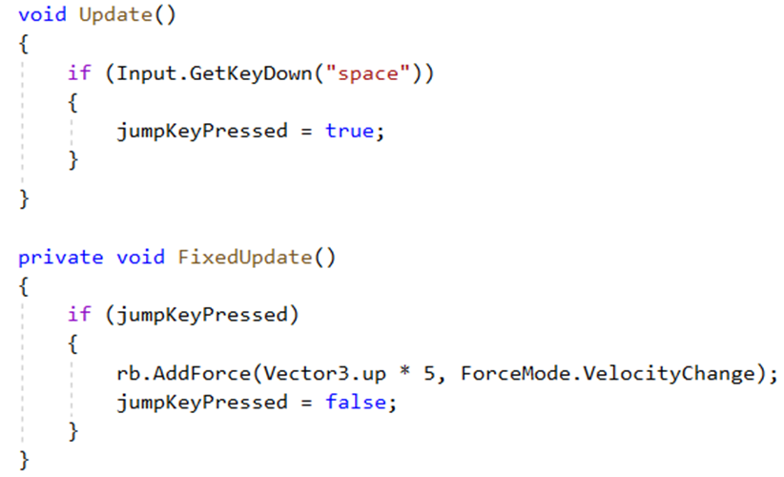
Update and FixedUpdate

Slide 6
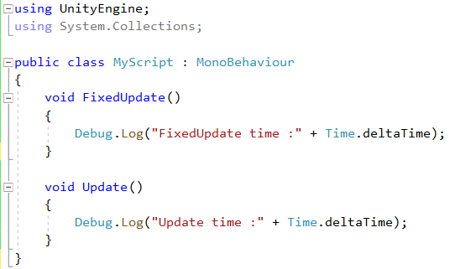
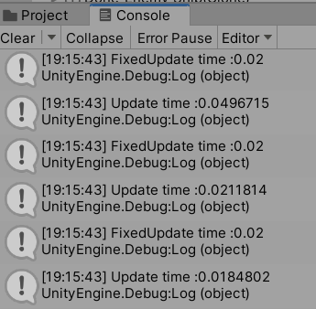

Slide 7


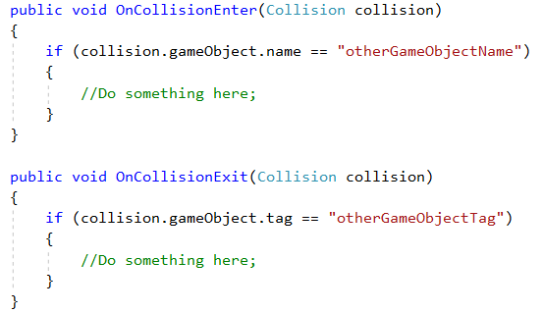

Slide 8
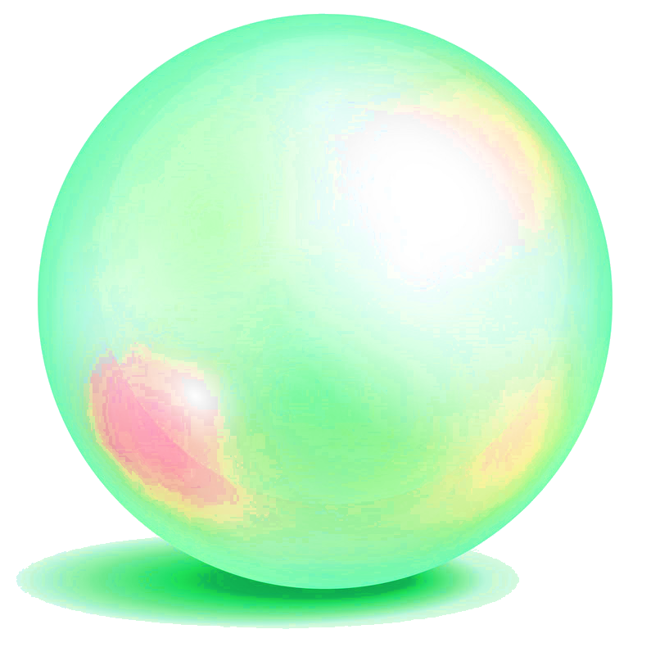
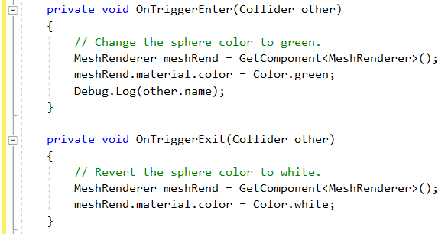

Slide 9
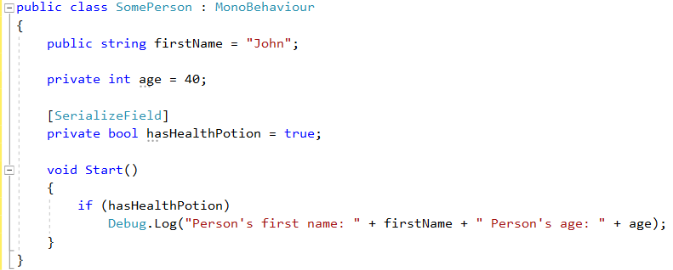

Slide 10
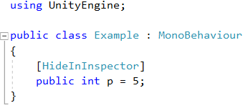

Slide 11
Namespaces
namespace Enemy {
public class Controller1 : MonoBehaviour {
...
}
public class Controller2 : MonoBehaviour {
...
}
}
using Enemy;
Controller1
//means Enemy.Controller1

Slide 12
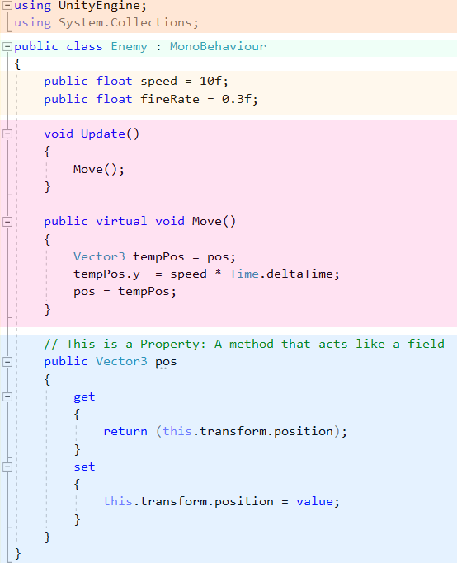

Slide 13
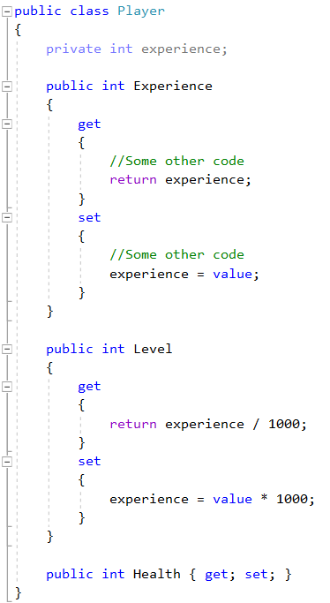
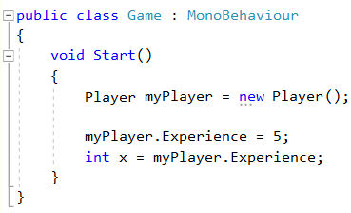
//Auto-implemented property

Slide 14
Important Unity Built-in Classes

Slide 15
Important Unity Variable Types
Built-in classes (hence upper case)
GameObject
MonoBehaviour
Transform
Quaternion
Mathf
Vector2, Vector3, Vector4
Color
Screen
SystemInfo
ScriptableObject
Debug
Gizmos, Handles
Time
Random

Slide 16
Vector3
Collection of 3 floats
Position of objects in 3D
Vector3 vec = new Vector3 (3, 4, 0);
Instance variables and functions
vec.x vec.y vec.z
vec.magnitude (read only)
vec.Normalize()
Static variables and functions
Vector3.zero i.e. new Vector3(0, 0, 0)
Vector3.Dot ( v_{A}, v_{B} )
Vector3.Cross (v_{A}, v_{B} )

Slide 17
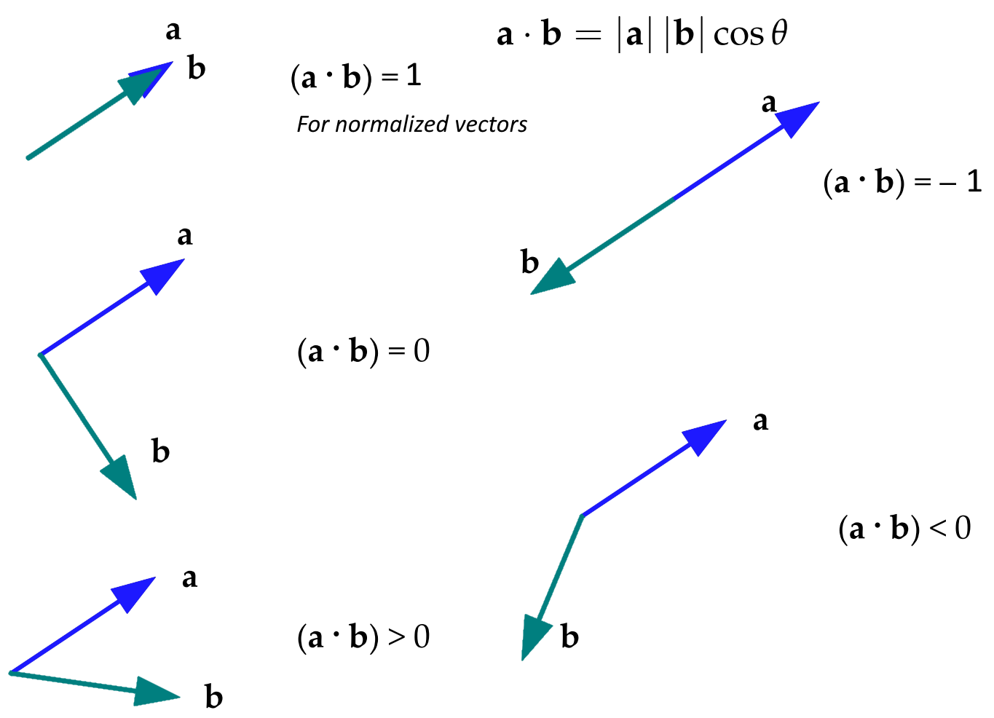

Slide 18
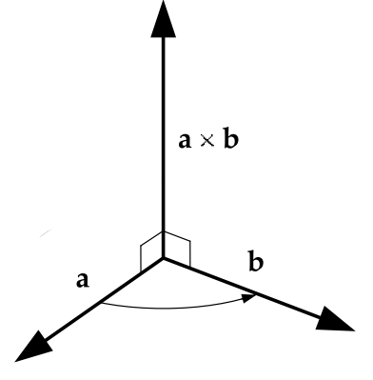
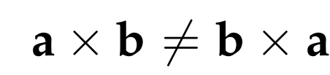
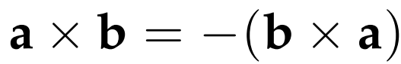

Slide 19
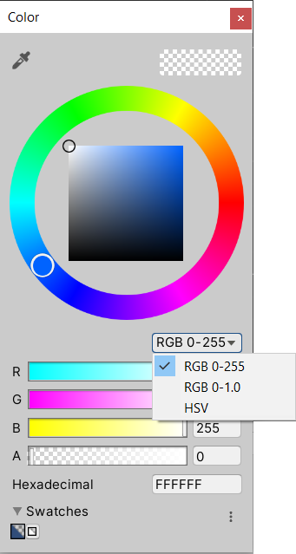
Color
Values range 0 - 1
Color col = new Color(0.5f, 0.5f, 0, 1f);
// Alpha optional
Color col = new Color(1f, 0f, 0f);
Unity color picker RGBA range 0–255
mapped to 0–1f
col.r
col.g
col.b
col.a // 1 opaque, 0 transparent

Slide 20
Color (cont)
Static variables
// Primary Colours
Color.red Color.green Color.blue
// Secondary Colours
Color.cyan // 0, 1, 1, 1
Color.magenta // 1, 0, 1, 1
Color.yellow // 1, 0.92f, 0.016f, 1 “Unity yellow”, standard yellow?
// Black, White, and Clear
Color.black Color.white
Color.grey // 0.5f, 0.5f, 0.5f, 1
Color.clear // 0, 0, 0, 0

Slide 21
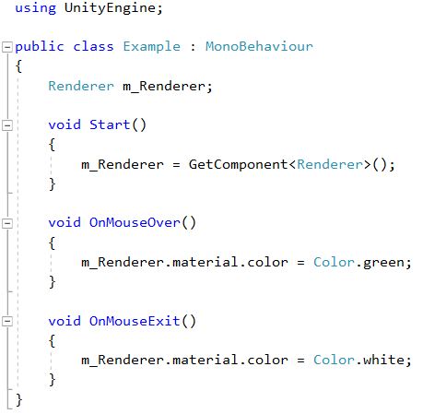

Slide 22
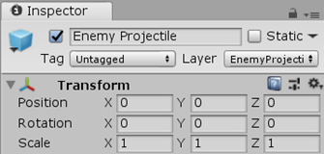
Quaternion
Rotation info
Quaternion rot = Quaternion.Euler(-45,0,0);
Rotations about axes
rot.eulerAngles; // Vector3 Euler angle representation
Quaternion.identity; // "no rotation" i.e. object aligned with world or parent axes
X, Y, Z values are converted to the Quaternion's internal format
Z > X > Y

Slide 23
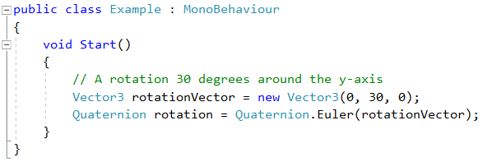

Slide 24
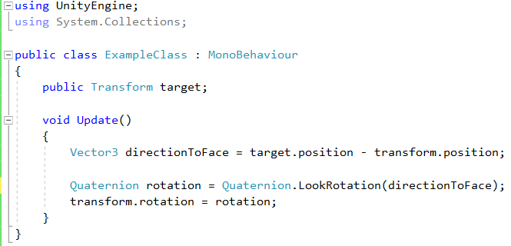

Slide 25
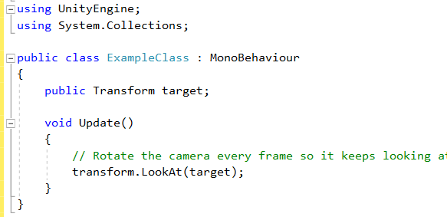
can be attached to a camera to make it
continuously point at an object.

Slide 26

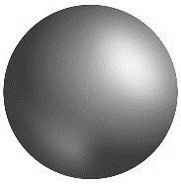
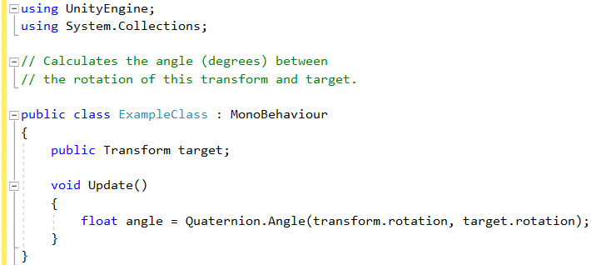


Slide 27
using UnityEngine;
public class ExampleScript : MonoBehaviour
{
float smooth = 5.0f;
float tiltAngle = 60.0f;
void Update()
{
float tiltAroundZ = Input.GetAxis("Horizontal") * tiltAngle;
float tiltAroundX = Input.GetAxis("Vertical") * tiltAngle;
Quaternion target = Quaternion.Euler(tiltAroundX, 0, tiltAroundZ);
transform.rotation = Quaternion.Slerp(transform.rotation, target, Time.deltaTime * smooth);
}
}

Slide 28
using UnityEngine;
public class Example : MonoBehaviour
{
public GameObject target;
void Update()
{
// Spin around target at 20 degrees/second.
transform.RotateAround(target.transform.position,
Vector3.up,
20 * Time.deltaTime);
}
}

Slide 29
var rot = Quaternion.Euler(0, 45, 0); // 45 degrees rotation around Y
var v45 = rot * Vector3.forward; // rotate vector 45 degrees around Y

Slide 30
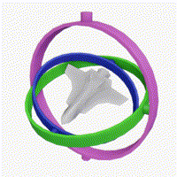
Quaternion (cont)
Less computational overhead
Quaternions better for keyframe interpolation
Avoid Gimbal Lock (2 Euler axes align)
But
Not as intuitive
See: https://docs.unity3d.com/Manual/QuaternionAndEulerRotationsInUnity.html

Slide 31
Mathf
Collection of static math functions
Mathf.Sin(x); Mathf.Cos(x); …
Mathf.PI;
Mathf.Min(2, 3, 1); Mathf.Max(2, 3, 1);
Mathf.Round(1.75f); Mathf.Ceil(1.75f); Mathf.Floor(1.75f);
Mathf.Abs(-25);
Mathf.lerp(3f, 5f, 0.5f);

Slide 32
Vector3 from = new Vector3 (1f, 2f, 3f);
Vector3 to = new Vector3 (5f, 6f, 7f);
// Here result = (4, 5, 6)
Vector3 result = Vector3.Lerp (from, to, 0.75f);
void Update ()
{
light.intensity = Mathf.Lerp ( light.intensity, 8f, 0.5f * Time.deltaTime ) ;
}

Slide 33
Screen
Info about display
List supported resolutions
Switch resolutions
Static class variables and functions
Screen.width Screen.height Screen.fullScreen
// Switch to 640 x 480 fullscreen
Screen.SetResolution(640, 480, true);
Screen.SetResolution(800, 600, false);

Slide 34
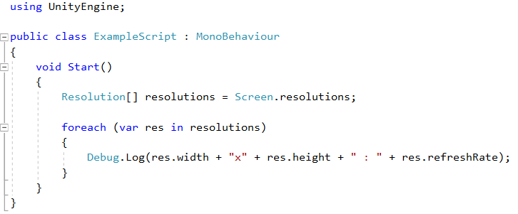

Slide 35
SystemInfo
Info about the device/computer
SystemInfo.operatingSystem
// OS version (e.g., Mac OS X 10.9.3)
SystemInfo.systemMemorySize

Slide 36
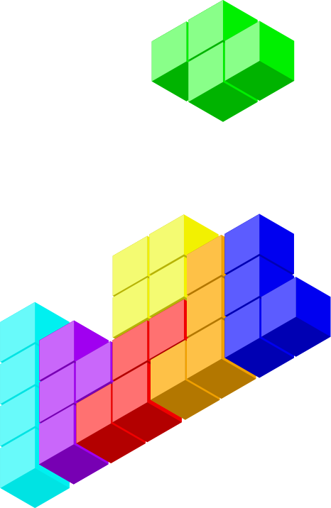
GameObjects

Slide 37
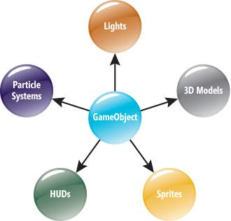
GameObject
Base class for all objects in scenes
Composed of components
Always has a Transform component
GameObject go = new GameObject("MyGO");
https://msdn.microsoft.com/
en-us/magazine/dn759441.aspx

Slide 38
GameObject (cont)
Instance variables and functions
go.name
go.transform
go.GetComponent<Transform>()
go.SetActive(false)
//access any attached component
GetComponent<ComponentType>()
anotherScript = GetComponent<AnotherScript>();
boxCol = otherGameObj.GetComponent<BoxCollider>();
=

Slide 39
Referencing GameObjects
If script is component of gameObject
this.gameObject or gameObject
If script not attached
1. Define public GameObject variable and attach in inspector
public GameObject target;
2. Search by name
GameObject target = GameObject.Find(“Enemy”);
3. Search by tag
GameObject target = GameObject.FindWithTag(“Player”);

Slide 40
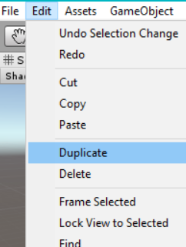
Instantiating Prefabs
Dynamically instantiate gameObjects from Prefabs
GameObject spawnedObject = Instantiate (prefabObject, position, rotation);
Similar to “Duplicate” command in editor
projectiles, explosions, AI enemies, …

Slide 41
using UnityEngine;
using System.Collections;
public class ExampleClass : MonoBehaviour
{
public GameObject respawnPrefab;
public GameObject[] respawns;
void Start()
{
if (respawns == null)
respawns = GameObject.FindGameObjectsWithTag("Respawn");
foreach (GameObject respawn in respawns)
{
Instantiate(respawnPrefab, respawn.transform.position, respawn.transform.rotation);
}
}
}

Slide 42
C# Collections

Slide 43
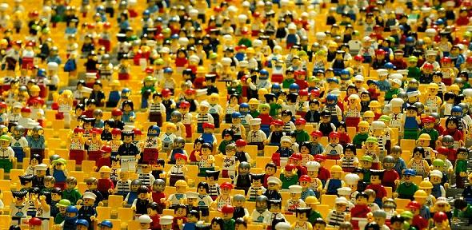
Collections
Array
List
HashSet
Dictionary
Hashtable
Stack
Queue

Slide 44
List
Add add object at end of List<T>
Remove remove first occurrence of object
Clear remove all elements
Contains whether element is in List<T>
Insert inserts element at index
Sort sorts elements
ToArray copies elements of List<T> to new array

Slide 45
using UnityEngine;
using System.Collections;
using System.Collections.Generic;
public class SomeClass : MonoBehaviour
{
void Start ()
{
List<BadGuy> badguys = new List<BadGuy>();
badguys.Add( new BadGuy("Harvey", 50));
badguys.Add( new BadGuy("Magneto", 100));
badguys.Add( new BadGuy("Pip", 5));
badguys.Sort();
foreach(BadGuy guy in badguys)
{
print (guy.name + " " + guy.power);
}
badguys.Clear();
}
}

Slide 46
using UnityEngine;
using System.Collections;
using System;
public class BadGuy : IComparable<BadGuy>
{
public string name;
public int power;
public BadGuy(string newName, int newPower)
{
name = newName;
power = newPower;
}
public int CompareTo(BadGuy other)
{
if(other == null)
{
return 1;
}
return power - other.power;
}
}
Required by IComparable interface
Allows us to use sort()

Slide 47
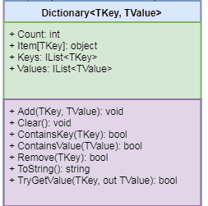
Dictionary
Add(TKey, TValue)
Remove(TKey)
ContainsKey(TKey)
ContainsValue(TValue)
TryGetValue(TKey, TValue)
Clear()

Slide 48
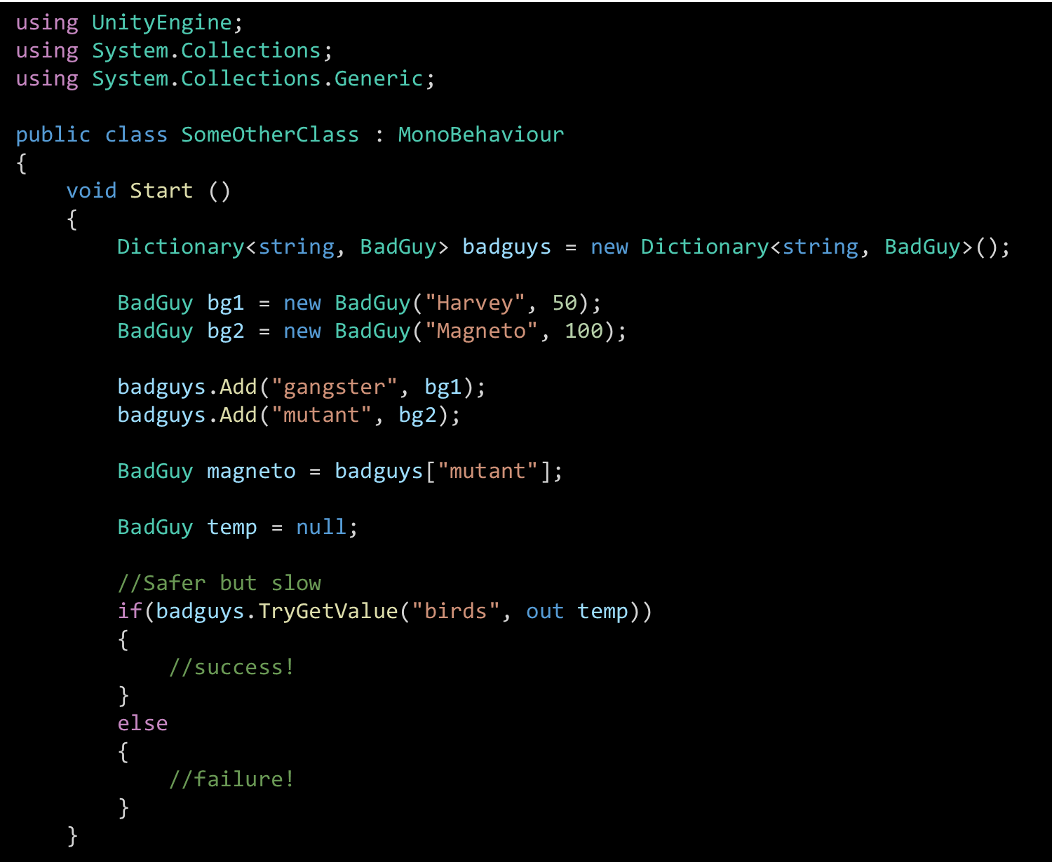
KeyNotFoundException possible
use try/catch

Slide 49
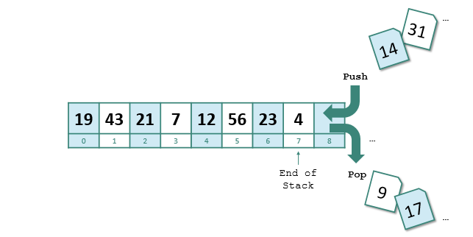
Stack
Push
Pop
Peek
LIFO
Stack<string> myStack = new Stack <string>();
myStack.Push("Hello");
myStack.Push("World");
myStack.Push("!");
foreach( string item in myStack )
{
Debug.Log(item);
}
!
World
Hello

Slide 50
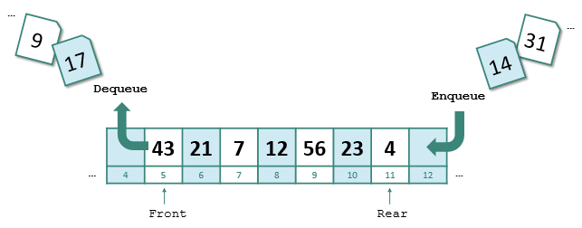
Queue
Enqueue
Dequeue
Peek
FIFO
Queue<string> myQ = new Queue<string>();
myQ.Enqueue("Hello");
myQ.Enqueue("World");
myQ.Enqueue("!");
foreach( string item in myQ )
{
Debug.Log(item);
}
Hello
World
!

Slide 51
GameObject Componets

Slide 52

Referencing Components
Public variable to hold reference in editor
public AudioSource enemyHit;
2. Through reference to gameObject
gameObject.GetComponent<AudioSource>();

Slide 53
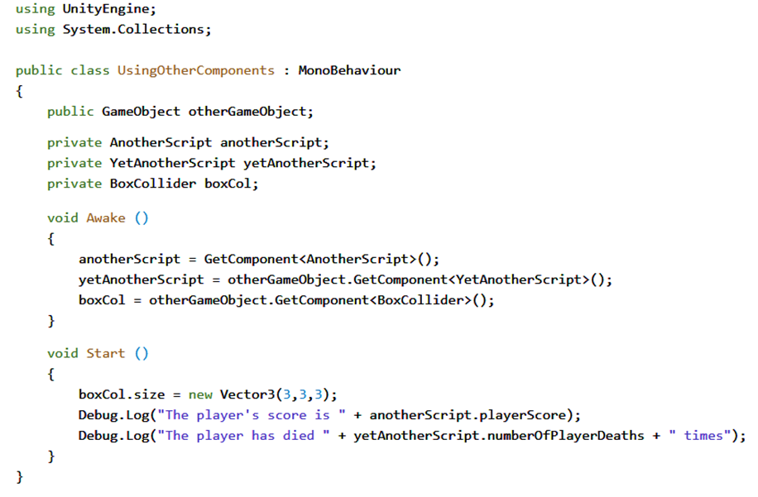
GetComponent is expensive. So it is better to call it in the Awake or Start function.

Slide 54
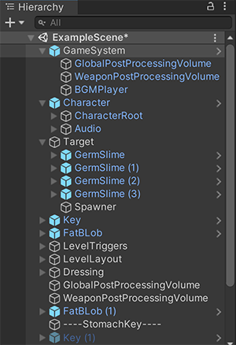
Transform Component
Controls position, rotation and scale
Transform tr = go.GetComponent<Transform>();
Also controls hierarchy (grouping) of objects
tr.parent
Children can be iterated over with foreach loop
foreach (Transform tChild in tr) { … }
Instance variables and functions
tr.position tr.rotation
tr.localScale tr.localPosition
tr.LookAt() tr.rotate()

Slide 55
using UnityEngine;
using System.Collections;
public class ExampleClass : MonoBehaviour
{
void Example()
{
transform.localPosition = Vector3.zero;
print(transform.localPosition.y);
}
}

Slide 56
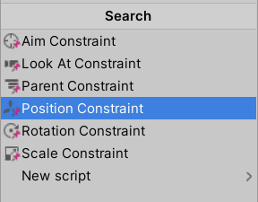
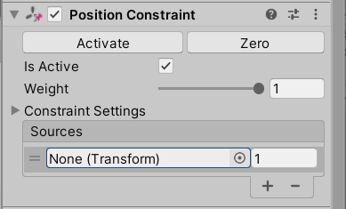
Constraints
Drag and drop source game object

Slide 57
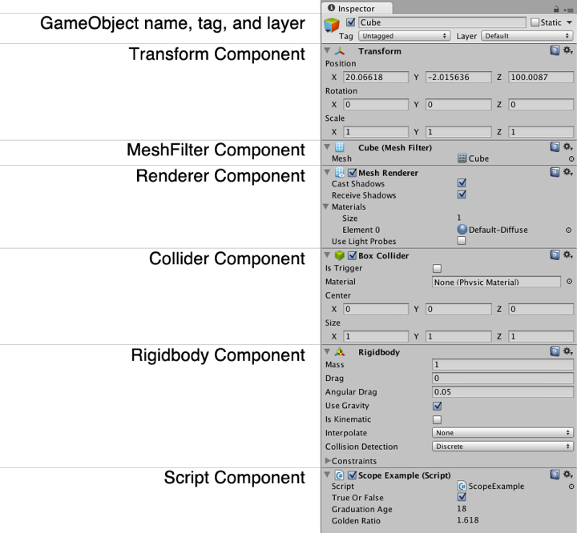
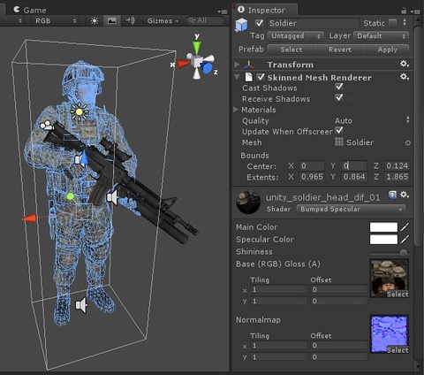
Rendering Components

Slide 58
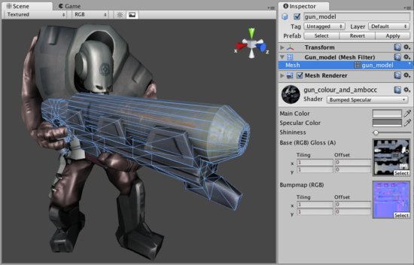
MeshFilter Component
The model you see
MeshFilter mf = go.GetComponent<MeshFilter>();
Attaches 3D model to GameObject
Rendered on screen by MeshRenderer

Slide 59
Renderer Component
Renderer rend = go.GetComponent<Renderer>();
Usually MeshRenderer (subclass of Renderer)
Combines MeshFilter with Material
Material = Textures + Shader
Materials accessed/modified through renderer
Disable to make objects invisible
rend.enabled = false;

Slide 60
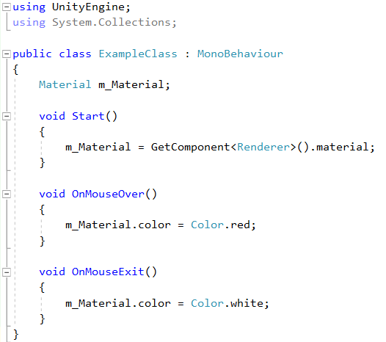

Slide 61
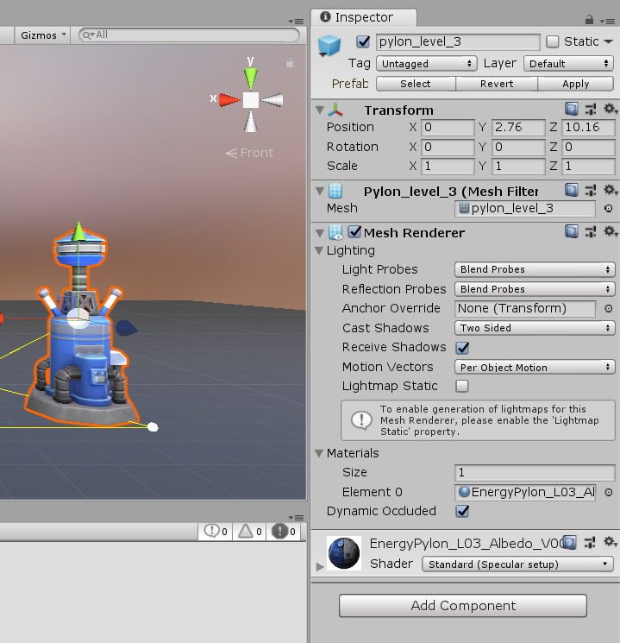
Renderer Component (cont)

Slide 62
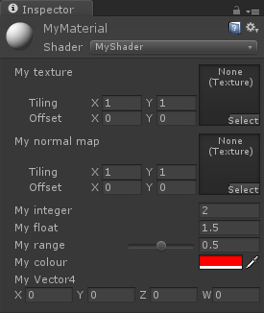
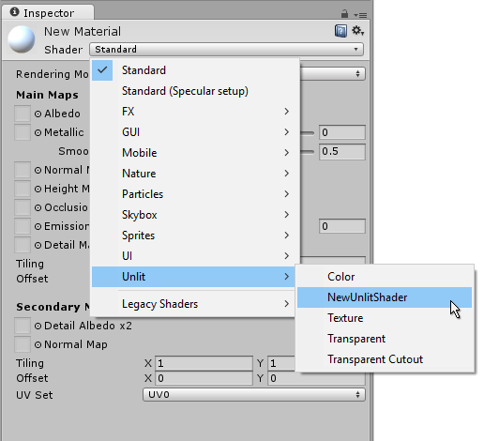
Renderer Component (cont)

Slide 63
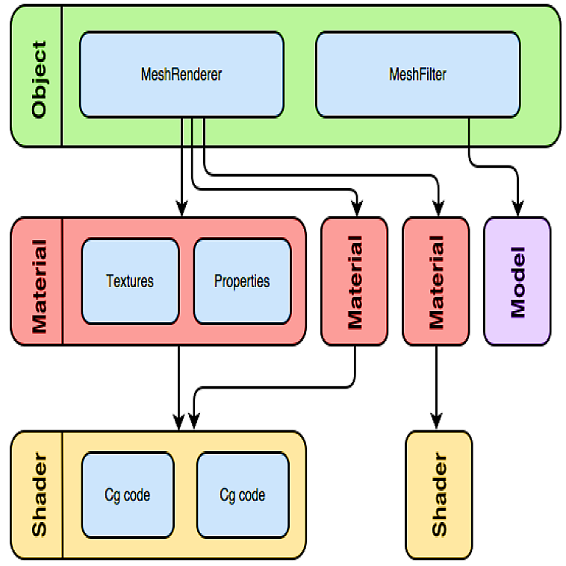

Slide 64
Collider Component
Physical presence of GameObject
Collider coll = go.GetComponent<Collider>();
Unity uses NVIDIA PhysX engine
Colliders will not move without Rigidbody component
Use colliders without Rigidbody for static objects
Collider with Rigidbody is considered dynamic

Slide 65
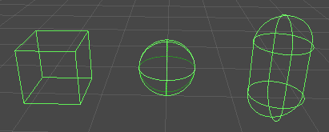
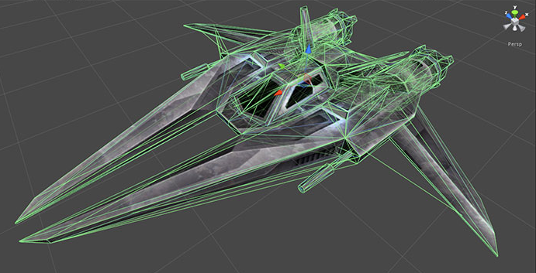
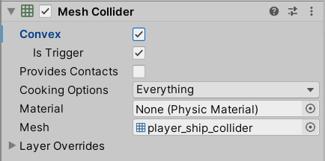
Collider Component (cont)
Types (ordered by complexity)
SphereCollider
CapsuleCollider
BoxCollider
MeshCollider
Using MeshFilter
Much slower
Select Convex to collide with other mesh colliders

Slide 66
Rigidbody Component
Physical simulation of GameObject
Velocity, bounciness, friction, gravity, etc
Rigidbody rb = go.GetComponent<Rigidbody>();
Updates every FixedUpdate()
Exactly 50 times per sec

Slide 67
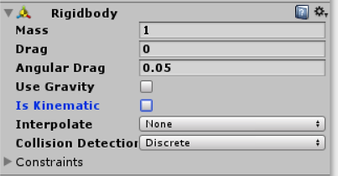
Rigidbody Component (cont)
Colliders will not move without Rigidbody
Motion under control of physics engine e.g. collision, gravity, etc
isKinematic
Collider will update but
GameObject position will not change automatically
Animation or transform position
rb.isKinematic = true

Slide 68
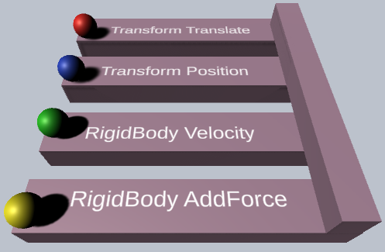
Moving GOs
Force
Acceleration
Impulse
VelocityChange
AddForce(Vector3 force, ForceMode mode = ForceMode.Force);
transform.position += transform.forward * speed * Time.deltaTime;

Slide 69
Scriptable Objects
Data container objects
Save data as an asset for runtime
Bound to project,
Not GO
Scene independent
Reduce memory usage
e.g. prefab instantiation

Slide 70
using UnityEngine;
[CreateAssetMenu(fileName = "Data",
menuName = "ScriptableObjects/SpawnManagerScriptableObject", order = 1)]
public class SpawnManagerScriptableObject : ScriptableObject
{
public string prefabName;
public int numberOfPrefabsToCreate;
public Vector3[] spawnPoints;
}

Slide 71
public class Spawner : MonoBehaviour
{
public GameObject entityToSpawn;
public SpawnManagerScriptableObject spawnManagerValues;
int entityNumber = 1;
void Start() { SpawnEntities(); }
void SpawnEntities()
{
int currentSpawnPointIndex = 0;
for (int i = 0; i < spawnManagerValues.numberOfPrefabsToCreate; i++)
{
GameObject currentEntity = Instantiate(entityToSpawn, spawnManagerValues.spawnPoints[currentSpawnPointIndex], Quaternion.identity);
currentEntity.name = spawnManagerValues.prefabName + entityNumber;
currentSpawnPointIndex++
entityNumber++;
}
}
}

Slide 72


Debugging

Slide 73

Debugging
Step through and watch your code running
Better understand code
Find errors and bugs
Track down inefficiencies
Debugging built into Unity via Visual Studio
VS debugger can attach to Unity to debug your code

Slide 74


Slide 75


Slide 76
Debugging
Types of Bugs
Compile-Time Bugs
Runtime Errors

Slide 77

Compile-Time Bugs
Code syntax
Compile-time bugs prevent code from compiling
Unusable until bug is resolved
Usually cause very specific errors
Line 4, character 14 of CubeSpawner1.cs

Slide 78
Compile-Time Bug (cont)
Full error text usually tells what's wrong
If not, google the error number
StackOverlow, Unity Discussions, …

Slide 79
Common Compile-Time Errors
error CS0101: The namespace 'global::' already contains a definition for …
Two scripts trying to define same class
error CS1525: Unexpected symbol '}'
Semicolon missing or a misplaced brace
;
{ }

Slide 80

Bugs Attaching Scripts to GameObjects
Error attempting to attach script to GameObject
Name of script not matching class name
e.g.
Script filename: CubeSpawner1
public class CubeSpawner : MonoBehaviour { … }

Slide 81
Runtime Errors
Bug when code is running
Unity cannot predict these
Most common
UnassignedReferenceException
NullReferenceException

Slide 82

Common Runtime Errors
UnassignedReferenceException
A variable in Inspector has not been set
e.g. prefab for Instantiate() calls

Slide 83


Common Runtime Errors (cont)
NullReferenceException
Trying to access something that doesn't exist

Slide 84
Conditional Compilation
public class PlatformDefines : MonoBehaviour {
void Start () {
#if UNITY_EDITOR
Debug.Log("Unity Editor");
#endif
#if UNITY_IOS
Debug.Log("iOS");
#endif
#if UNITY_STANDALONE_OSX
Debug.Log("Standalone OSX");
#endif
#if UNITY_STANDALONE_WIN
Debug.Log("Standalone Windows");
#endif
}
}

Slide 85

Disabling Logs in Game Build
Platform Dependent Compilation
https://docs.unity3d.com/Manual/PlatformDependentCompilation.html

Slide 86
Topic Summary
Creating Unity C# scripts, namespaces, properties, …
Some Unity built-in classes; Quaternion, ScriptableObject,…
Transform, renderer, materials, shaders, rigidbody, …
Instantiating GameObjects at runtime
Moving GameObjects with transform or physics
Referencing GameObjects and components
Constraints; position, scale, …
Configuring GameObject components
Debugging with Visual Studio, Studio Code
SendMessage, BroadcastMessage, …
C# collections; List, Dictionary, Queue, Stack, …

